Slide 1


Health Credits Unification of policy, industry and market to promote healthier consumption and lifestyle
Learn Imagine Decide
Kathryn Lavercombe (TAL)
Andrew Yin (TAL)
Charles Kuan (TAL)
Oliver Dolk (UNSW)
Daniel Han-Chen (UNSW)
Xavier Holt (Macquarie University)

Slide 2




From Health Score to Health Credits
At [Learn Imagine Decide], we have developed a Health Score that connects food groups to health outcomes.
The food we eat impacts our health
On the basis of our Health Score, we propose a Health Credit system that rewards production, distribution and consumption of healthy foods.
As a tradeable currency, our Health Credit system enables market forces to determine the price of “health” and influence behaviours.
Retailers impact consumer choices
Data used: SA3 conversion, PNH data, SA3 health, World Smart Shopping, QANTAS portfolio data, ABS Income Data, ABS Health

Slide 3

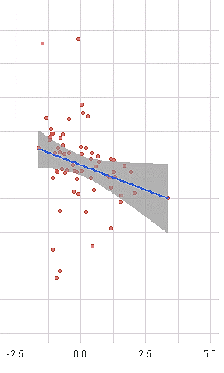
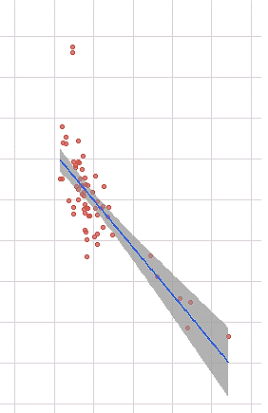
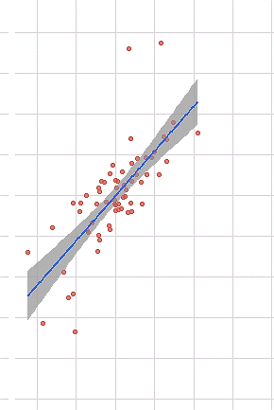
From VicHealth, we learn the cost of lifestyle diseases. From Worldsmart, we learn what people are buying. From ABS, we learn more about ourselves, where we live and how we are connected. Blending the data, we developed a Health Score that intuitively correlates food groups to health.
Health Credits based on Product-Segregated Health Scores
Fruits
Vegetables
Confectionary
UNHEALTHY
HEALTHIER
EAT MORE
The MORE fruits you eat, the HIGHER your Health score
The MORE vegs you eat, the HIGHER your Health score
The MORE sweets you eat, the LOWER your Health score
Data used: SA3 conversion, PNH data, SA3 health, World Smart Shopping, QANTAS portfolio data, ABS Income Data, ABS Health

Slide 4
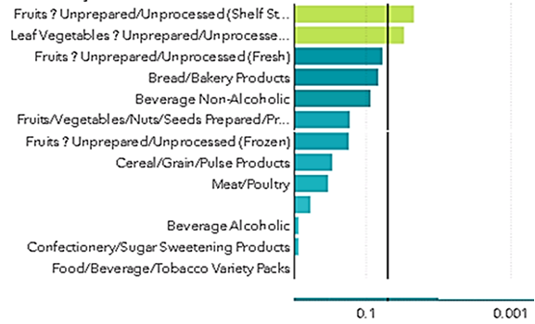
Health Score as a product segregator
The important variables of the predictive model used to determine the Health Score are intuitively connected with food groups widely regarded as healthy.
Data used: SA3 conversion, PNH data, SA3 health, World Smart Shopping, QANTAS portfolio data, ABS Income Data, ABS Health

Slide 5
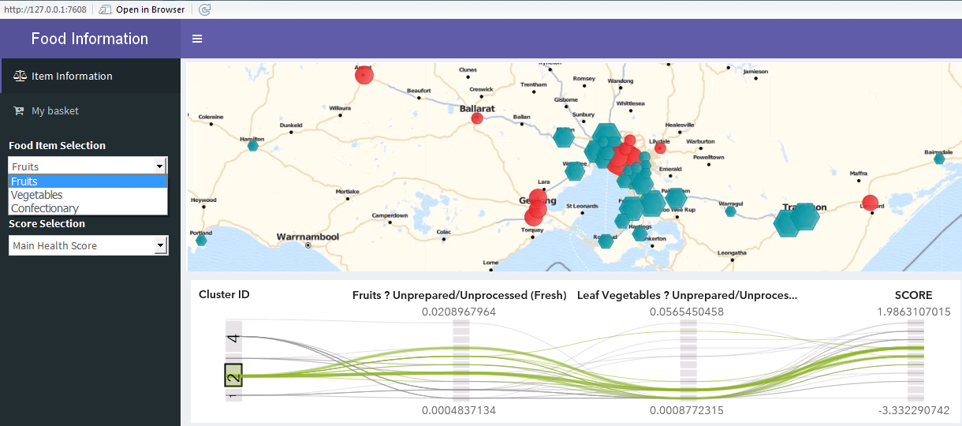
We developed web applications to enable policymakers, lobby groups, industry and individuals to make informed choices from health credit design to healthy food choices. We plan on integrating our APIs with point-of-sale systems.
Data-driven insights and solutions

Slide 6

We verified that the health score was impartial to age, gender and socio-economic factors such as income and geographical location. We believe the benefits of healthy living should remain universal to all, including the young and the old, the rich and the poor.
Balancing the social impact
Age and Gender (Male/Female)
Health Score
Age Groups
Income
Location

Slide 7



Health Credits in operation
Health Score rates the healthiness of products
HIGH = healthy LOW = unhealthy
Heath Rating
Voluntary Participating Retailers
→ Count all healthy products sold – receipt evidence
Retailers
Government (ATO) or other
If good outcome, provide:
Tax Deduction
Rewards Subsidies
Healthy Certified Sticker - Recognition
Feedback
Cycle
Government
Get rewards
Promote healthy products – healthy ads
Healthy foods price reduction
Retailers

Slide 8
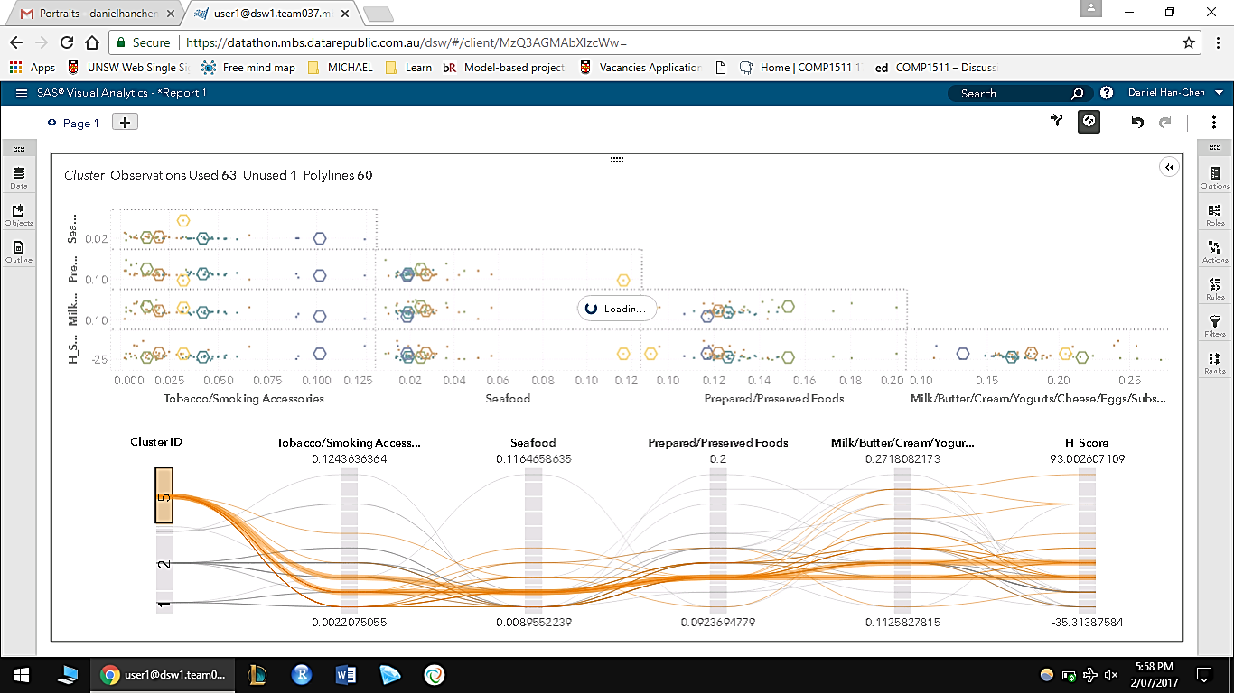
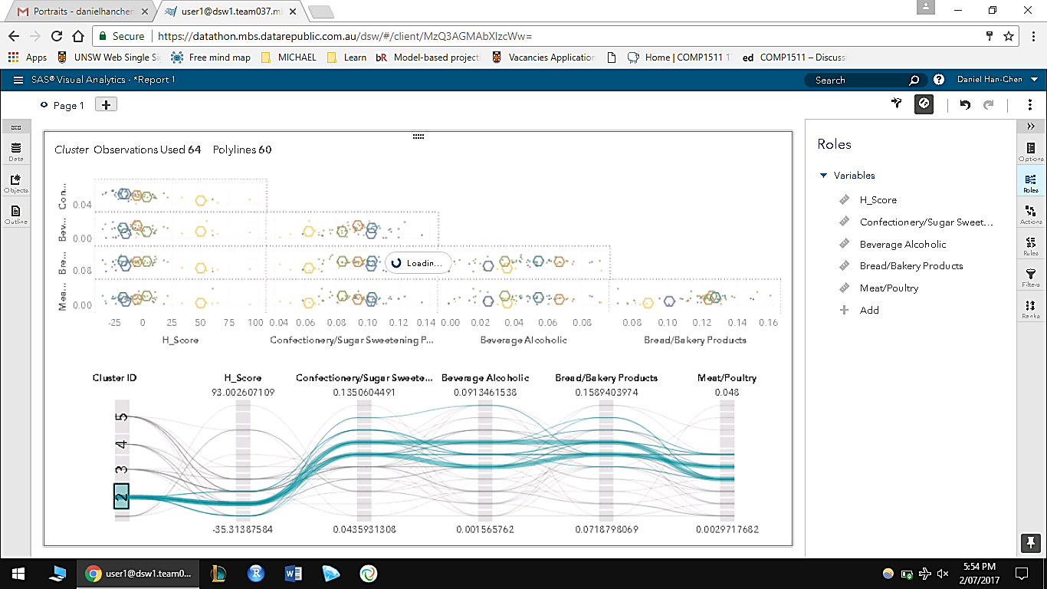
Does it actually work?
Retailer A
Decides to Join
$10 Tobacco
$100 Dairy
$100 Seafood
Health Score 2
LITTLE REWARD / LITTLE TAX DEDUCTION
Retailer B
Decides to join
$1000 Sweets
$1000 Alcohol
$1000 Meat
Health Score -35
NO REWARD / NO TAX DEDUCTION
Data used: SA3 conversion, PNH data, SA3 health, World Smart Shopping, QANTAS portfolio data, ABS Income Data, ABS Health

Slide 9
Multiplier Benefits for Government, Industry and Consumers
Better public health increases workforce productivity
Government
Producers
Distributors and Retailers
Consumers
Healthcare and Insurance
Health credits and market forces favours healthier produce
Health credit trading and productivity improvements increases taxation revenue
Producers increases supply of healthier produce
Reduce obesity, heart disease, diabetes and other lifestyle conditions
Reduce public healthcare costs
Greater supply reduces cost of healthier produce
Health Credits
Reduces insurance claims cost and premiums
Strengthens financial health
Higher revenue and profitability from healthier produce
More affordable healthy produce
Chooses healthier produce
Increases availability and promotion of healthier produce
Live healthier lives

